Slide 1

Training Presentation:
My Patient Summary (MPS) Tool
Name
Name
Name
Title
Title
Title

Slide 2
Learning Objectives
The purpose and benefits of the My Patient Summary tool
How to configure your My Patient Summary dashboard
How to set My Patient Summary as your default landing page
Helpful tips for using and managing your dashboard

Slide 3
1.
The purpose and benefits of the
My Patient Summary tool

Slide 4
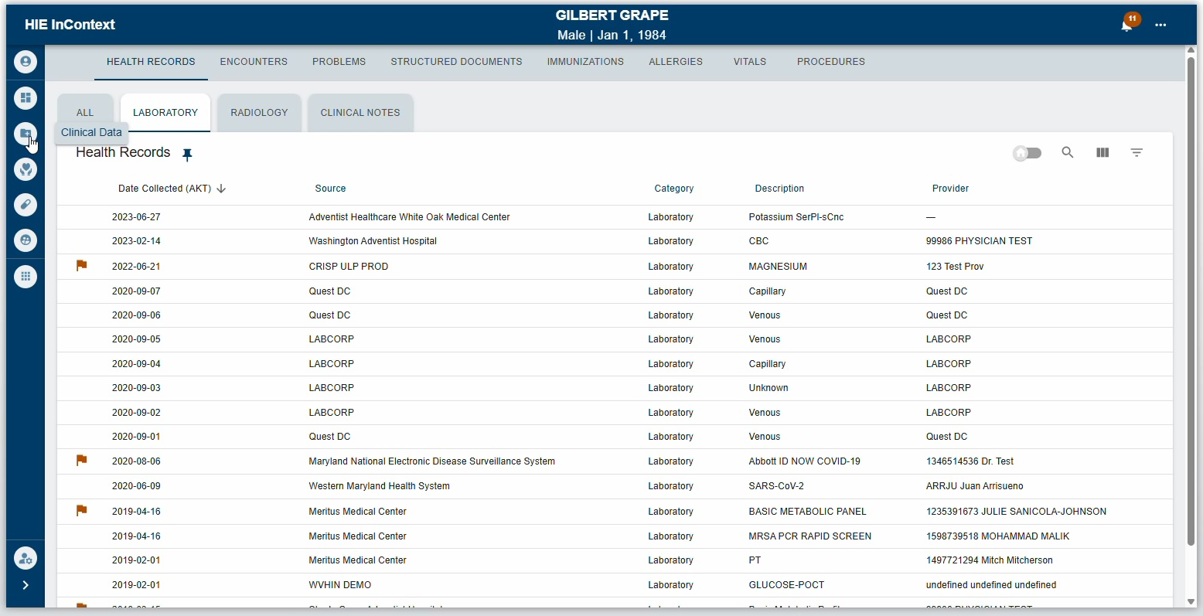
What is My Patient Summary?
BEFORE:
A customizable dashboard in the HIE Portal
Lets each user create a personalized view of the patient information most relevant to their role and workflow.
Instead of navigating across multiple tabs and subtabs to access specific data, MPS consolidates selected views into a single dashboard.

Slide 5
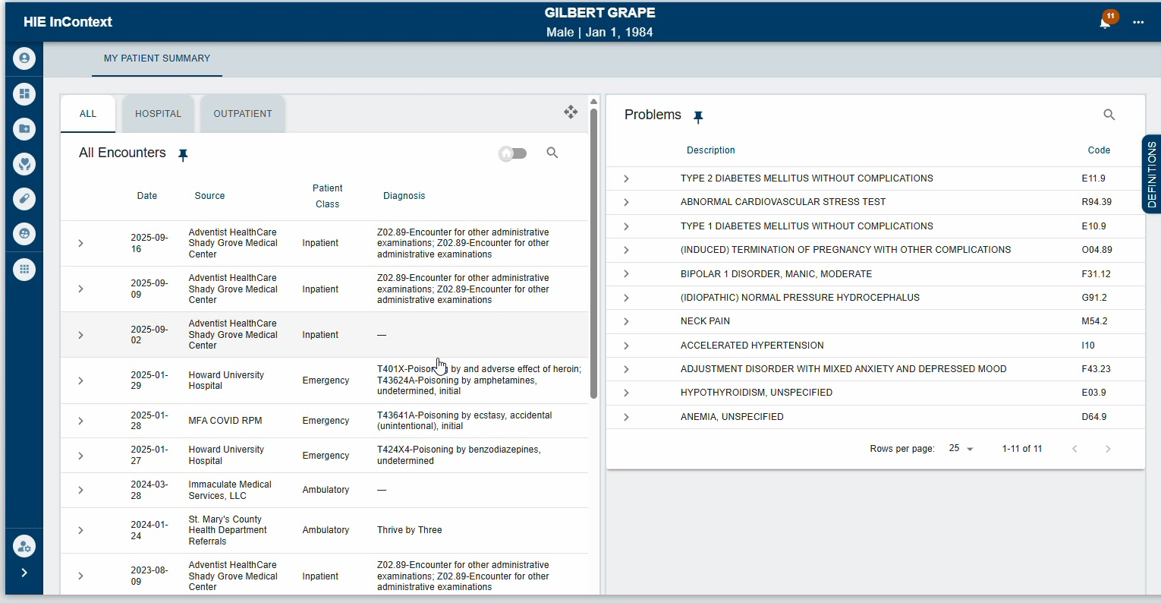
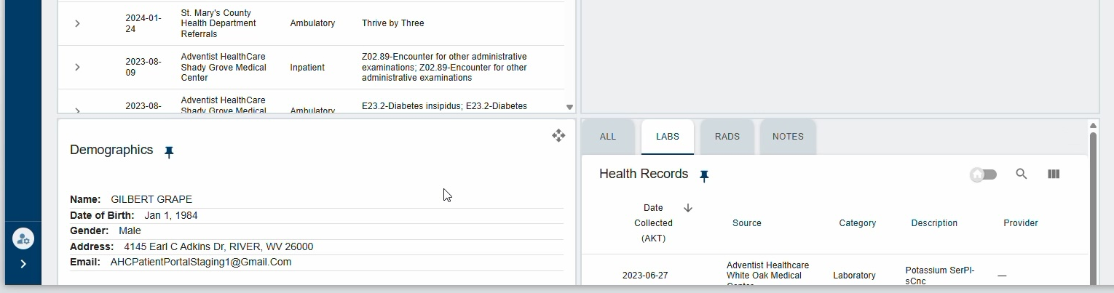
How it works
MPS made up of pinned tabs or subtabs from elsewhere in the portal
You can pin up to 8 items
Each pinned item appears as its own window (tile)
Tiles display live data and retain the same functionality as their original tab views
Once configured, your layout applies across all patient charts you view
AFTER:

Slide 6
2.
How to configure your
My Patient Summary dashboard

Slide 7
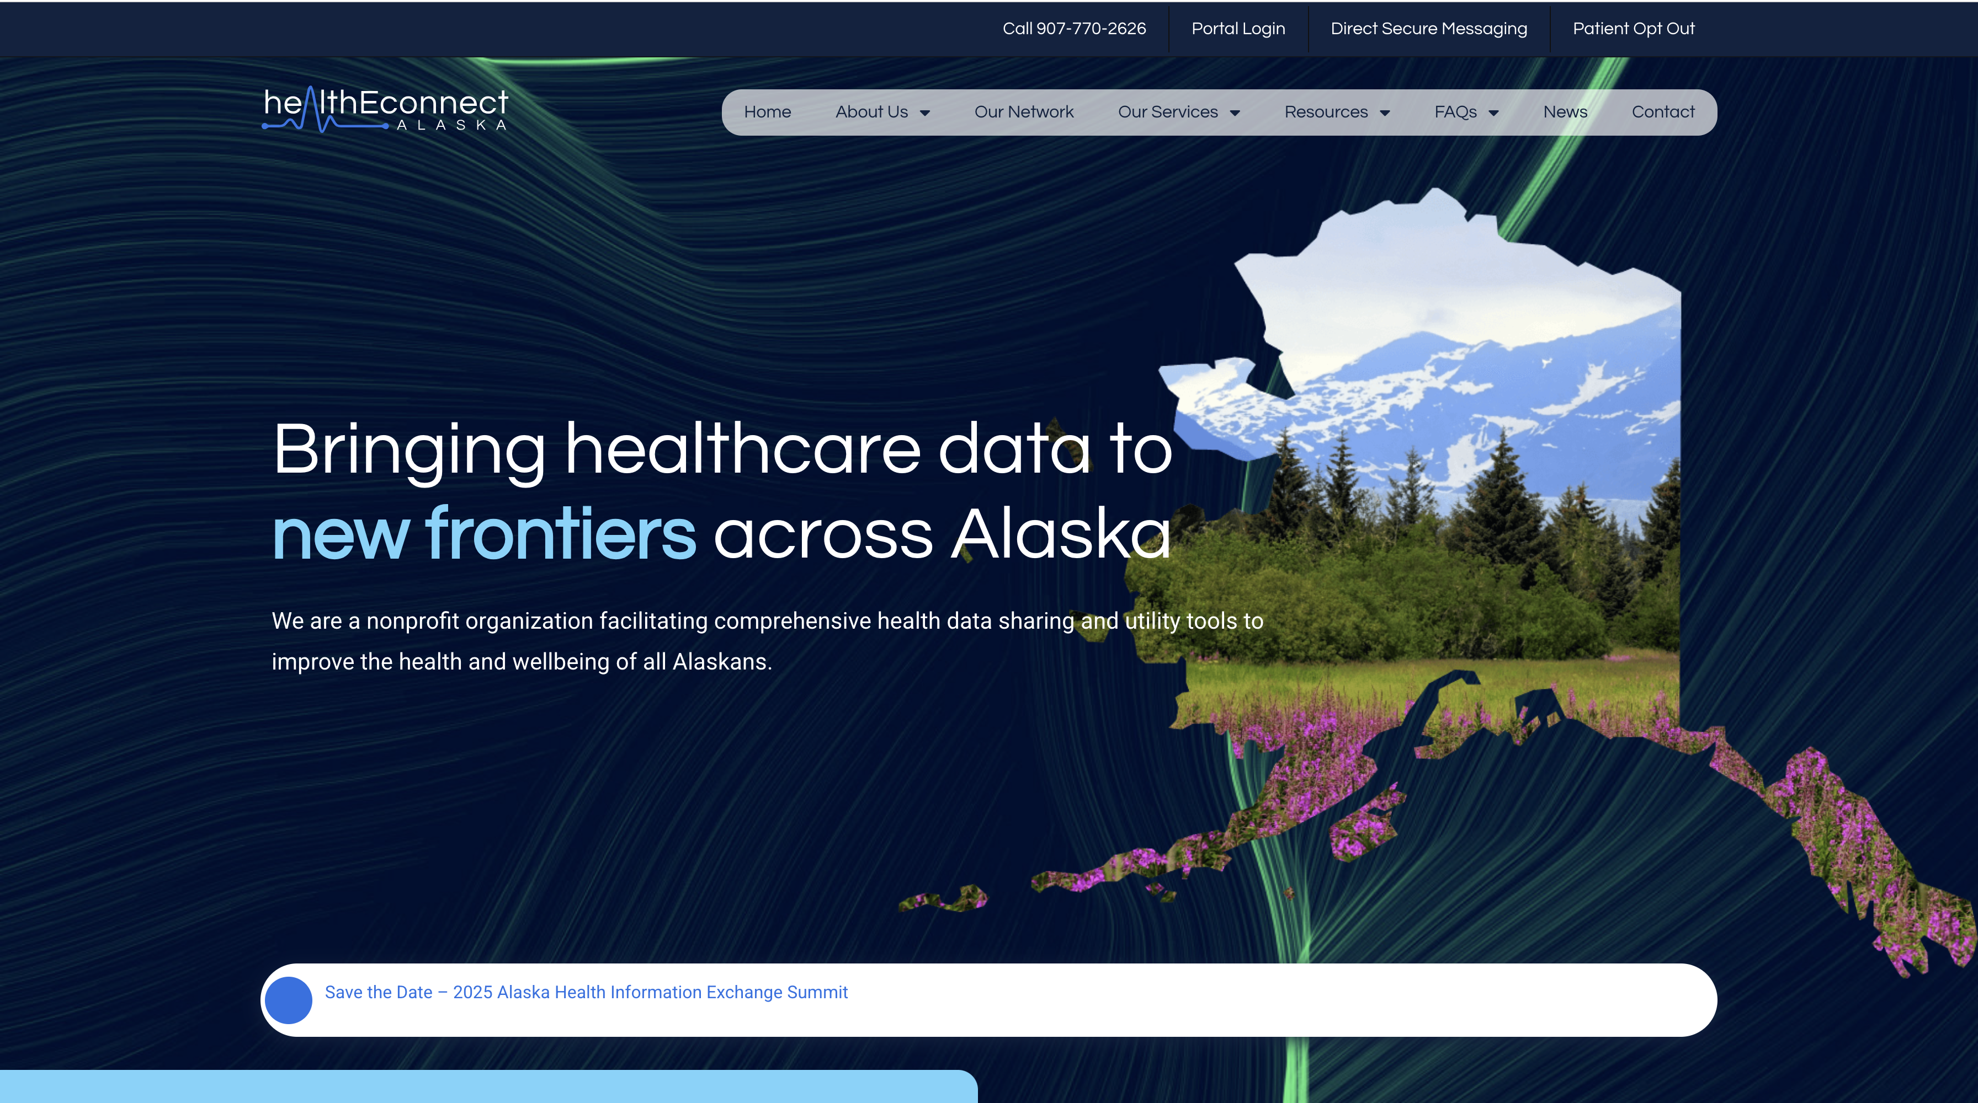
Log into the HIE Portal: Web
Go to healthEconnectAK.org and select Portal Login.
Tip: Bookmark this URL for quick access in the future.

Slide 8
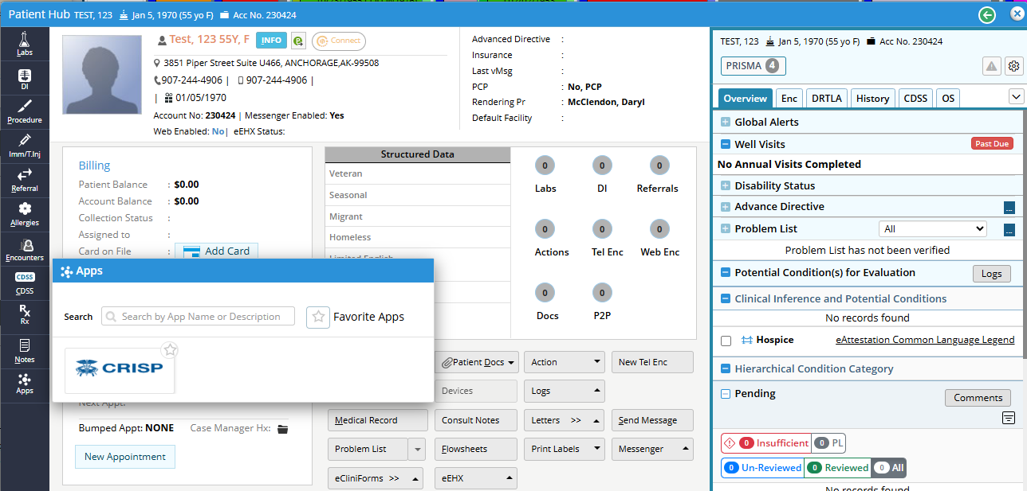
Log into the HIE Portal: SSO
Single Sign-On (SSO) organizations access the HIE Portal directly through their EMR/EHR

Slide 9
NOTE:
Initial setup must be completed from within a patient chart. Once configured, your dashboard settings will carry over to all patient charts you access.

Slide 10
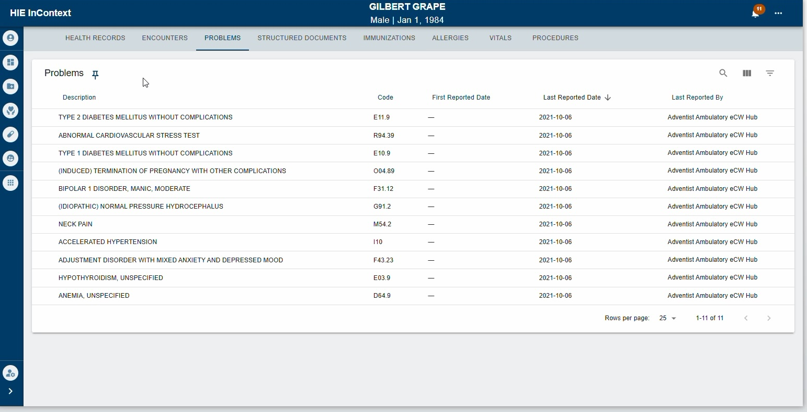
Select Tabs or Subtabs to Include
Navigate through the available tabs and subtabs to locate the views most useful for your workflow.
To add an item to your dashboard, click the pushpin icon next to the tab /subtab title.
You may pin up to 8 total items.

Slide 11


Pinning & Unpinning
A solid (filled) pin indicates the item is pinned. An empty pin indicates the item is not pinned.
To remove an item, click the solid pin again to unpin it. This can be done from the original tab or from within My Patient Summary.
= Already pinned to MPS Dashboard
= Not pinned to the MPS Dashboard

Slide 12
NOTE:
Please view our Introduction to the HIE Portal guide or video to learn more about the contents of each tab and subtab in the HIE Portal.

Slide 13
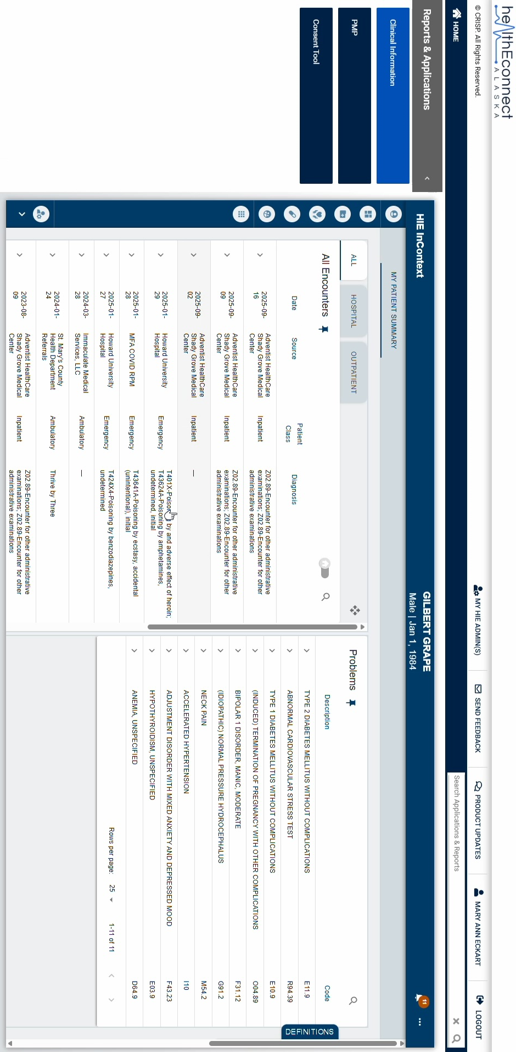
Accessing MPS Dashboard
Once you have pinned at least one item:
Open the My Patient Summary tab from the patient navigation menu.
Your dashboard will display tiled windows containing your pinned items.

Slide 14
Rearranging Your Dashboard
Hover over the tile or window you wish to move.
A four-way arrow icon will appear in the top right.
Click and drag this icon to rearrange tiles in your preferred order.
Your layout changes are saved automatically.

Slide 15
3.
Setting My Patient Summary as Your Default View

Slide 16
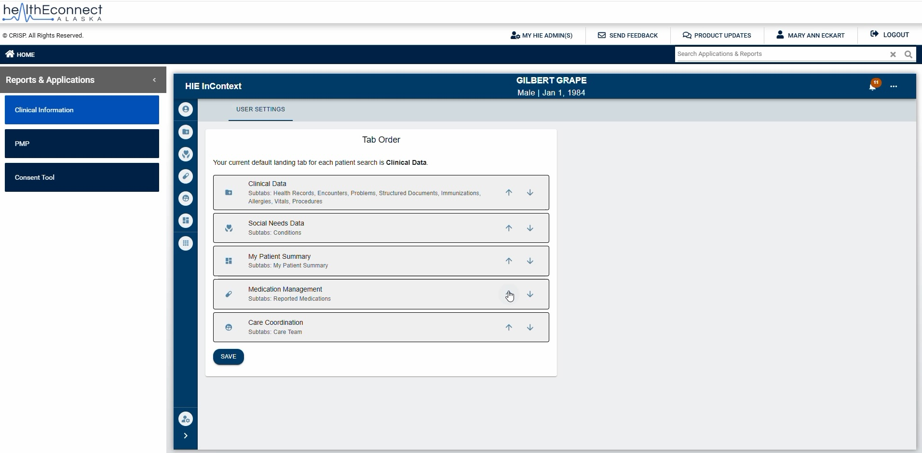
Access User Settings
Click on the user settings icon

Slide 17
Rearrange Tabs
Use the arrows to reorder the list.
Move My Patient Summary to the top of the list to make it your default view.
Click Save.

Slide 18
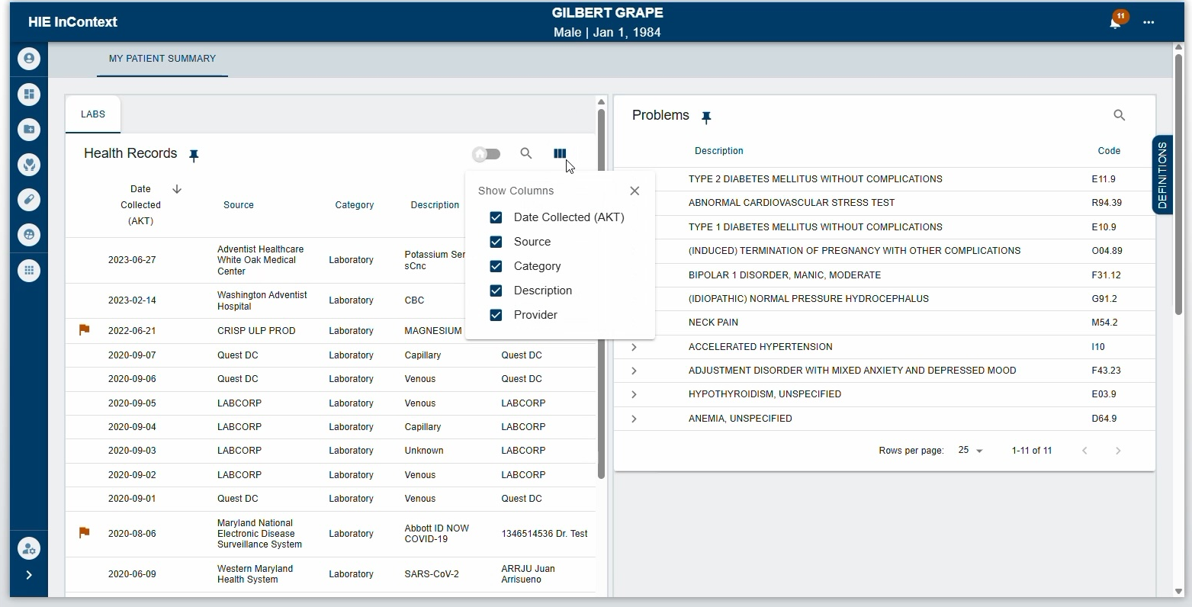
Data Controls
All standard data controls remain available within pinned tiles, including:
Search
Sort
Column display options
Hide My Organization Data (when applicable)

Slide 19

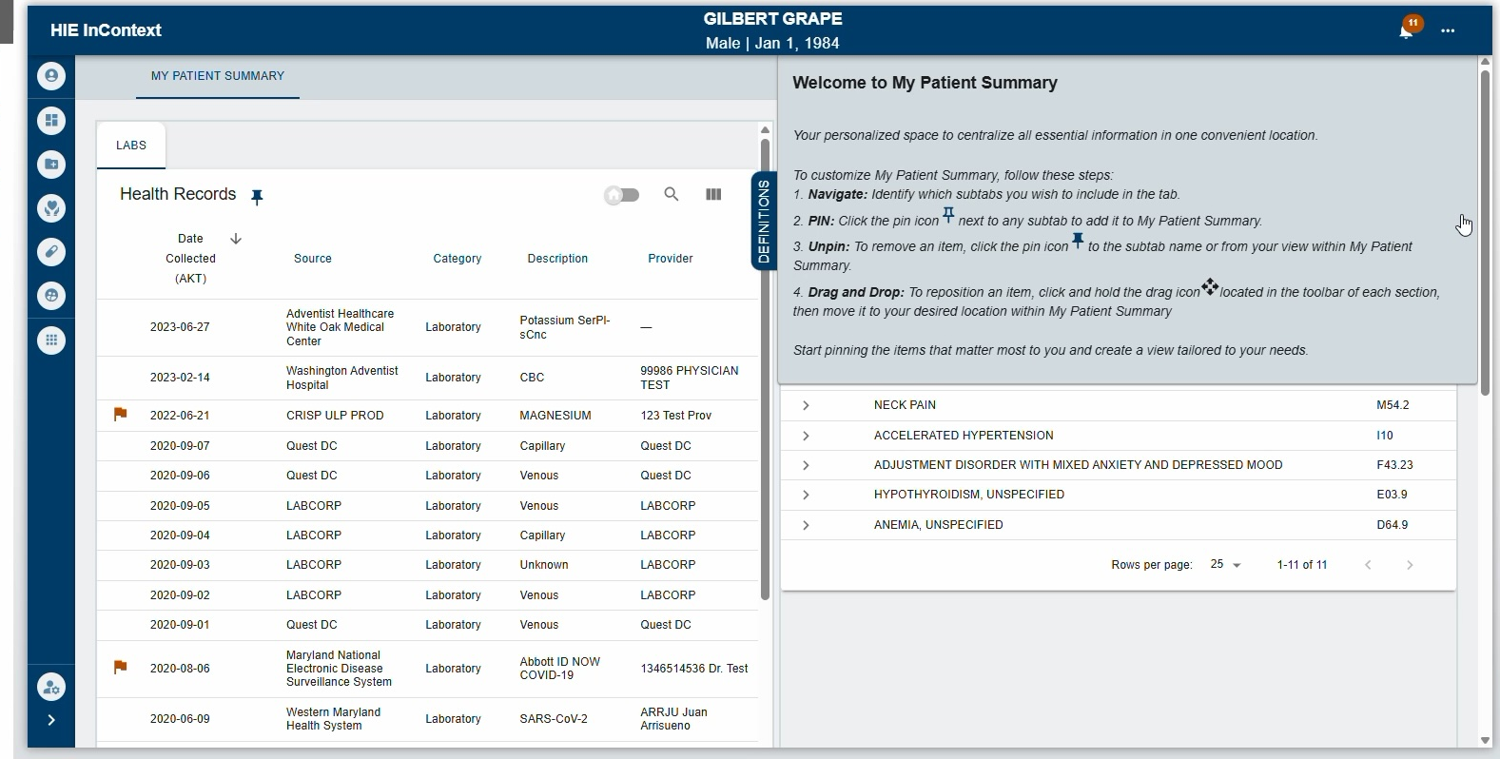
Instructions
Quick reference instructions are always available in MPS.
Click the retractable drawer labeled Definitions.
This instruction panel is available whenever at least one tab is pinned.

Slide 20
What we learned
The purpose and benefits of the My Patient Summary tool
How to configure your My Patient Summary dashboard
How to set My Patient Summary as your default landing page
Helpful tips for using and managing your dashboard

Slide 21
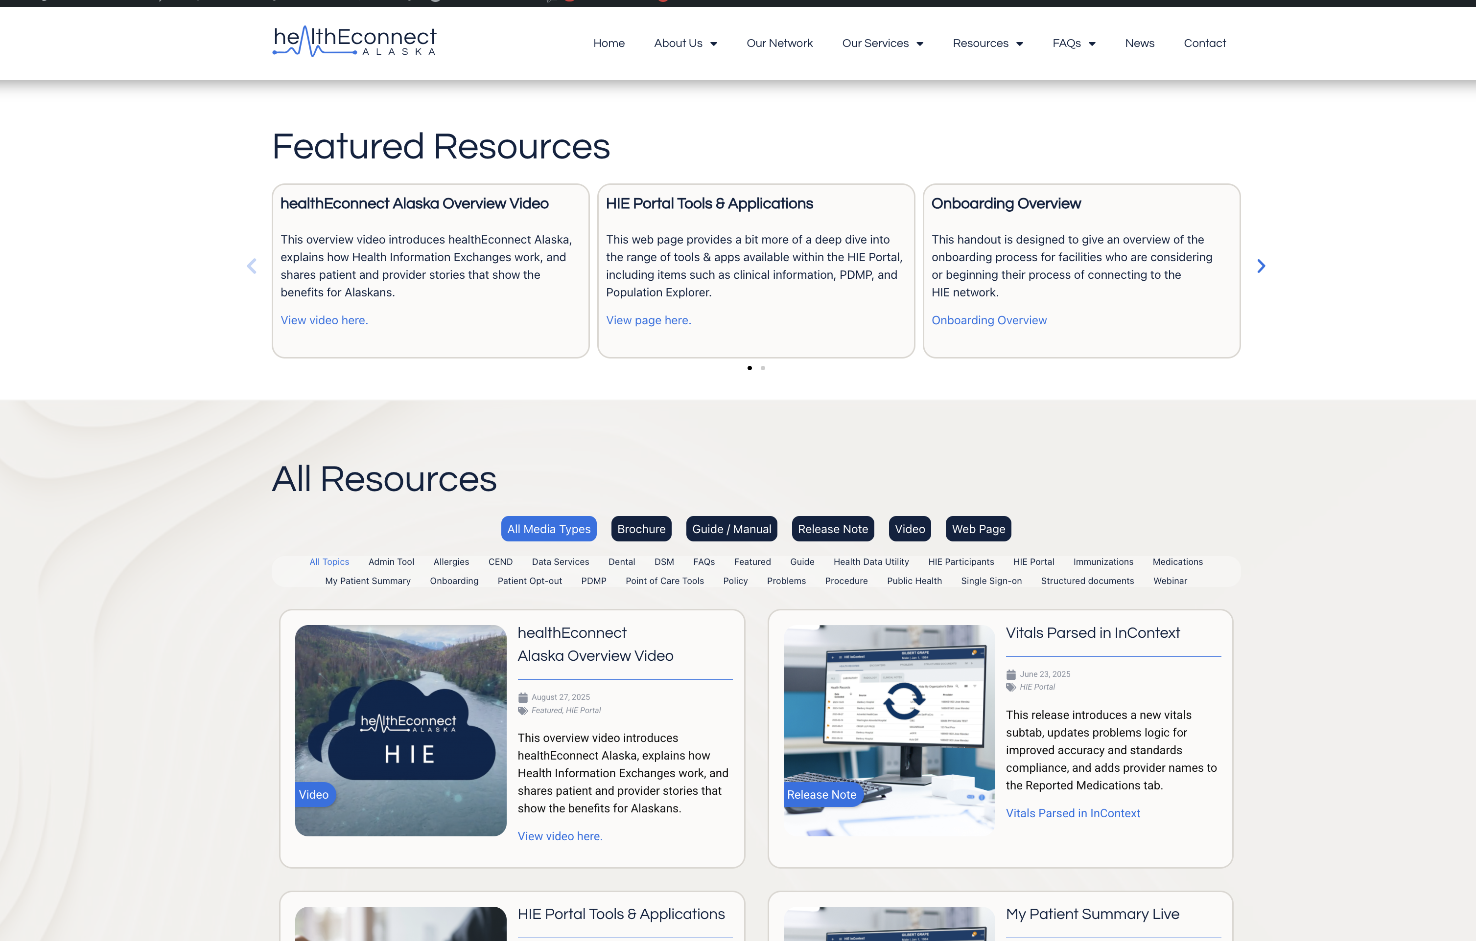
Related Topics
Overview of the HIE Portal
2-factor authentication
Population Explorer tool
healthEconnectAK.org/Resources

Slide 22

DEMONSTRATIONS OR MORE INFORMATION
info@healtheconnectak.org
HELP WITH EXISTING ACCOUNTS
support@healtheconnectak.org
healthEconnect WEBSITE
https://www.healtheconnectak.org

